Slide 1
Hadoop Introduction
Wang Xiaobo
2011-12-8

Slide 2
Outline
Install hadoop
HDFS
MapReduce
WordCount Analyzing
Compile image data

Slide 3
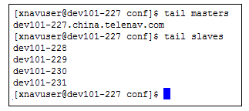
Install hadoop
Download and unzip Hadoop
Install JDK 1.6 or higher version
SSH Key Authentication
master/salves
Config hadoop-env.sh export JAVA_HOME=/usr/local/jdk1.6.0_16
core-site.xml/hdfs-site.xml/mapred-site.xml
Startup/Shutdown sh start-all.sh sh stop-all.sh

Slide 4
Install hadoop
Monitor Hadoop http://172.16.101.227:50030 http://172.16.101.227:50070
Shell commands hadoop dsf -ls hadoop jar ../hadoop-0.20.2-examples.jar wordcount input/ output/

Slide 5

HDFS

Slide 6
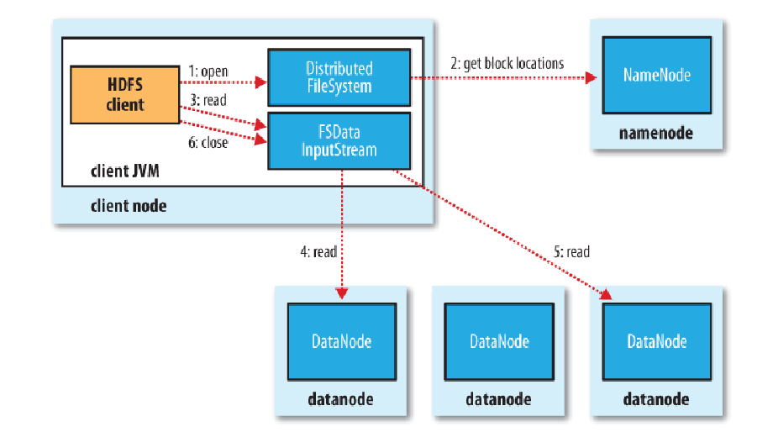
HDFS

Slide 7
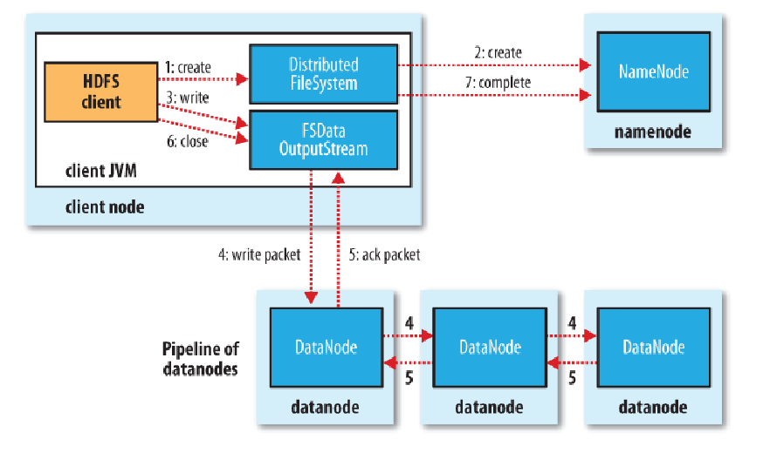
HDFS

Slide 8
HDFS
Single namenode
Block storage (64M)
Replication
Big file
Not suit for low latency App
Not suit for large numbers of small file 150 millions files need 32G memory
Single user write

Slide 9
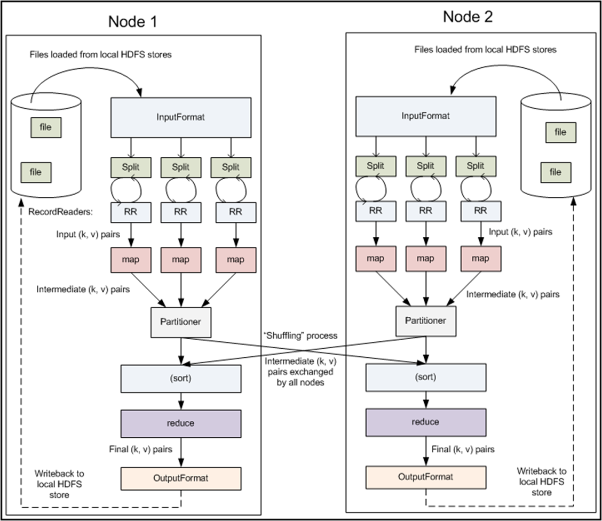
MapReduce

Slide 10
MapReduce
InputFormat InputSpliter RecordReader
Combiner Same as Reducer，but run in Map local machine
Partitioner Control the load of each reducer, default is even
Reducer RecodWriter
OutputFormat

Slide 11
WrodCount
public static void main(String[] args) throws Exception { Configuration conf = new Configuration(); Job job = new Job(conf, “word count”); //设置一个用户定义的job名称 job.setJarByClass(WordCount.class); job.setMapperClass(TokenizerMapper.class); //为job设置Mapper类 job.setCombinerClass(IntSumReducer.class); //为job设置Combiner类 job.setReducerClass(IntSumReducer.class); //为job设置Reducer类 job.setOutputKeyClass(Text.class); //为job的输出数据设置Key类 job.setOutputValueClass(IntWritable.class); //为job输出设置value类 FileInputFormat.addInputPath(job, new Path(otherArgs[0])); //为job设置输入路径 FileOutputFormat.setOutputPath(job, new Path(otherArgs[1]));//为job设置输出路径 System.exit(job.waitForCompletion(true) ? 0 : 1); //运行job }

Slide 12
WrodCount
public static class TokenizerMapper extends Mapper<Object, Text, Text, IntWritable>{ private final static IntWritable one = new IntWritable(1); private Text word = new Text(); public void map(Object key, Text value, Context context ) throws IOException, InterruptedException { StringTokenizer itr = new StringTokenizer(value.toString()); while (itr.hasMoreTokens()) { word.set(itr.nextToken()); context.write(word, one); } } }

Slide 13
WrodCount
Input the Apache Hadoop software library is a framework that allows for the…
Map <the, 1> <Apache, 1> … <the, 1>
Reducer <the, [1,1]> <Apache, [1]>
Output <the, 2> <Apache, 1>

Slide 14
WrodCount
Input the Apache Hadoop software library is a framework that allows for the…
Map <the, 1> <Apache, 1> … <the, 1>
Reducer <the, [1,1]> <Apache, [1]>
Output <the, 2> <Apache, 1>

Slide 15
Use Hadoop to compile image data
Old compiler

Slide 16
Use Hadoop to compile image data

Slide 17
Use Hadoop to compile image data
write.to.txd.job
traffic.job
write.traffic.to.txd.job
data.prepare.job
collision.detection.job0
collision.detection.job1
write.to.label.job
collision.detection.job5
collision.detection.job6
write.to.largelabel.job
collision.detection.job3
collision.detection.job4
write.to.dpoi.job

Slide 18
Use Hadoop to compile image data
Reduce compile time from 5 days to 5 hours

Slide 19
Q&A
Thanks！

